Slide 1
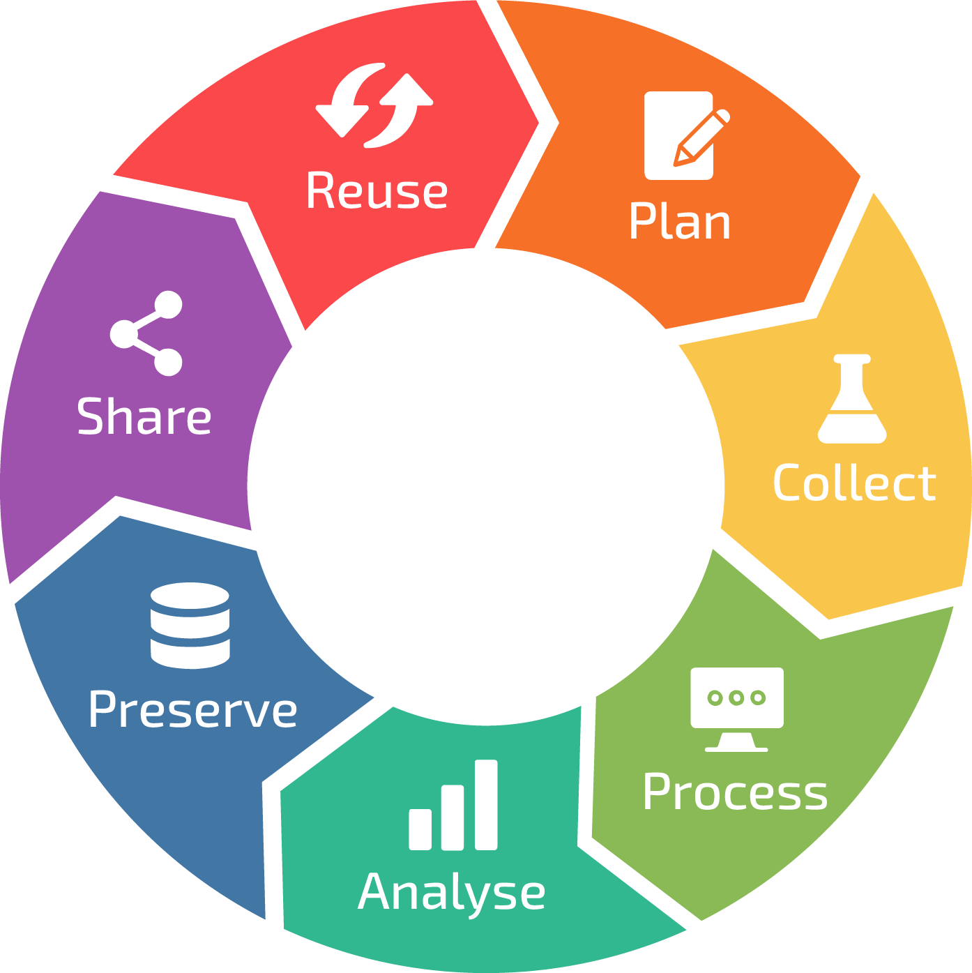
ML Health
TriCARE
Set Project Predict Objectives
DigiHealth
Design Predict System parameters.
Medic
Manufacture Predict sensors.
Data Types
Project WORD documentation
Project plans – VISIO etc.
Data Types
ML model file
ML Heath + DigiHealth to update ML model based on historical accuracy and Patient health (from daily and Yr. 3 Trial survey data).
Data Types
Text
XL – accuracy score
XML Sensor data
Research Dashboard -PPT/BI reports
Share
Alert Triage action to TriCare.
TriCare share ML accuracy in Triage recommendations presented to Data Scientists in ML Health.
Alert Medic of faulty sensor.
Present Yr. 3 Trial research dashboard to ML Health + TriCARE to assess project effectiveness based on research.
Capture
Patient profile data from TriCare for ML Health + DigiHealth modelling.
Patient Sensor Data.
ML Health Researcher Yr. 3 Trial data (post interview).
Sensor diagnostic data.
Data Types
Survey questions
Sensor metrics;
BP
Activity
Blood glucose
XML sensor files
Predict
Project
Data Types
Relational DB store
XML sensor data
Store
Patient
Sensor data (purge DB for records aged > 12 months).
Dashboard reports.
Actual Triage Outcomes.
General health (from interview data).
Nurse/ML Triage recommendations
Sensor diagnostic data.
Data Types
XL, CSV data files
On screen text (patient dashboard)
Survey data
Process
Patient profile data to allow ML Health + DigiHealth build Triage ML model.
Patient sensor data reviewed by Nurse/ML.
Assess Sensor diagnostic data.
Collate Yr. 3 Trial ML Health Researcher data.
Nurse/ML derive Patient Triage recommendation.
ML Health + DigiHealth evaluate Triage ML model accuracy score.
System determines if sensor faulty.
Format Yr. 3 Trial research data analysis.
Data Types
Text
Numerical score
XML sensor data
XL/PPT/BI output (research)

